Slide 5
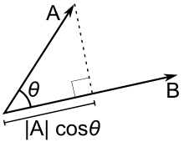
Dot (Scalar) Product:
The dot product of two vectors gives a scalar, that means only the magnitude is left, no direction. Mathematically, it is equal to the product of the magnitude of two vectors times the cosine of the angle between the two. ie.
v⃗ ⋅u⃗ =|v⃗ ||u⃗ |Cosθ

Slide 6
DOT PRODUCT
Example 2
If the vectors a and b have lengths 4 and 6, and the angle between them is π/3, find a ∙ b.
Using Theorem 3, we have: a ∙ b = |a||b| cos(π/3) = 4 ∙ 6 ∙ ½ = 12

Slide 7
DOT PRODUCT
The formula in Theorem 3 also enables us to find the angle between two vectors.

Slide 8
NONZERO VECTORS
Corollary 6
If θ is the angle between the nonzero vectors a and b, then

Slide 9
NONZERO VECTORS
Example 3
Find the angle between the vectors a = ‹2, 2, –1› and b = ‹5, –3, 2›

Slide 10
NONZERO VECTORS
Example 3
Also, a ∙ b = 2(5) + 2(–3) +(–1)(2) = 2

Slide 11
NONZERO VECTORS
Example 3
Thus, from Corollary 6, we have:
So, the angle between a and b is:

Slide 12
ORTHOGONAL VECTORS
Two nonzero vectors a and b are called perpendicular or orthogonal if the angle between them is θ = π/2.

Slide 13
ORTHOGONAL VECTORS
Then, Theorem 3 gives: a ∙ b = |a||b| cos(π/2) = 0
Conversely, if a ∙ b = 0, then cos θ = 0; so, θ = π/2.

Slide 14
ZERO VECTORS
The zero vector 0 is considered to be perpendicular to all vectors.
Therefore, we have the following method for determining whether two vectors are orthogonal.

Slide 15
ORTHOGONAL VECTORS
Theorem 7
Two vectors a and b are orthogonal if and only if a ∙ b = 0

Slide 16
DOT PRODUCT
As cos θ > 0 if 0 ≤ θ < π/2 and cos θ < 0 if π/2 < θ ≤ π, we see that a ∙ b is positive for θ < π/2 and negative for θ > π/2.
We can think of a ∙ b as measuring the extent to which a and b point in the same direction.

Slide 17
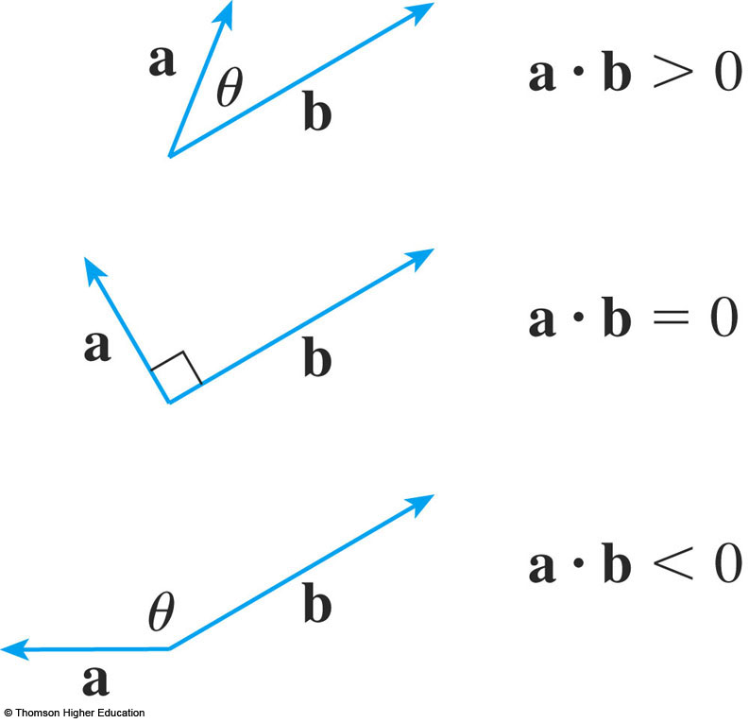
DOT PRODUCT
The dot product a ∙ b is:
Positive, if a and b point in the same general direction
Zero, if they are perpendicular
Negative, if they point in generally opposite directions

Slide 18
DOT PRODUCT
In the extreme case where a and b point in exactly the same direction, we have θ = 0.
So, cos θ = 1 and a ∙ b = |a||b|

Slide 34
Norm, Vector Norm, Matrix Norm
Norm Function:
In linear algebra, functional analysis, and related areas of mathematics:
A Norm is a function that assigns a strictly positive length or size to each vector in a vector space.
Matrix norm has been widely applied to many areas such as computer vision, pattern recognition, biological study and etc.

Slide 35
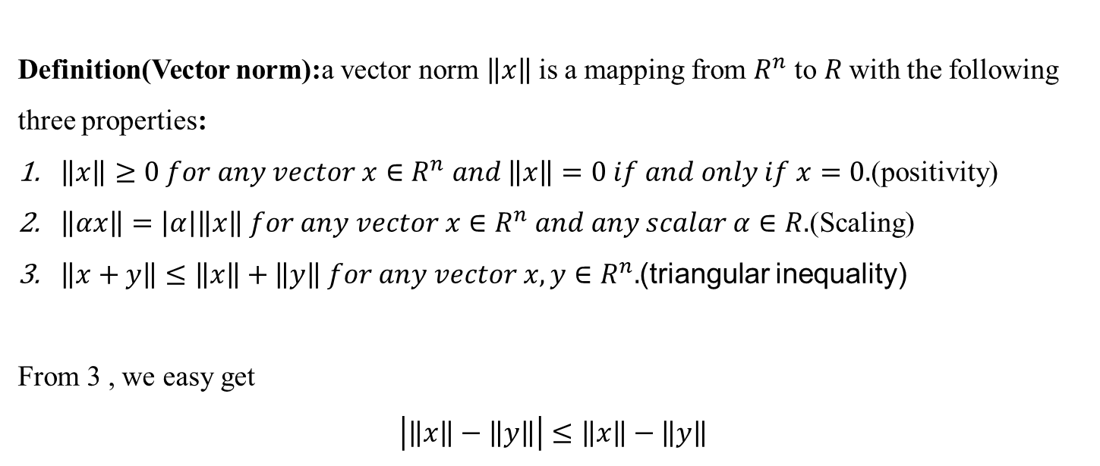
Norm, Vector Norm, Matrix Norm
Definition(Vector norm):a vector norm $\left\|x\right\|$is a mapping from $R^{n}$ to $R$with the following three properties:
$\left\|x\right\|≥0 for any vector x∈R^{n} and \left\|x\right\|=0 if and only if x=0.$(positivity)
$\left\|αx\right\|=\left|α\right|\left\|x\right\| for any vector x∈R^{n} and any scalar α∈R.$(Scaling)
$\left\|x+y\right\|≤\left\|x\right\|+\left\|y\right\| for any vector x,y∈R^{n}.$(triangular inequality)
From 3 , we easy get
$$\left|\left\|x\right\|−\left\|y\right\|\right|≤\left\|x\right\|−\left\|y\right\|$$

Slide 36

Norms
$l_{p}−norms$:
${\left\|x\right\|}_{p}={\left(\sum_{i=1}^{n}{{\left|x_{i}\right|}^{p}}\right)}^{1/p}$
The following 𝑙_𝑝−𝑛𝑜𝑟𝑚𝑠 are of particular interest:
$p=1,l_{1}−norms$
$$\left\|x\right\|=\left|x_{1}\right|+\left|x_{2}\right|+…+\left|x_{n}\right|$$
$p=2,l_{2}−norms or Euclidian norms:$
$${\left\|x\right\|}_{2}=\sqrt{x_{1}^{2}+x_{2}^{2}+…+x_{n}^{2}}=\sqrt{x^{T}x}$$
$p=∞,The l_{∞}−norms$
$${\left\|x\right\|}_{∞}=\max_{1≤i≤n}\left|x_{i}\right|$$

Slide 37
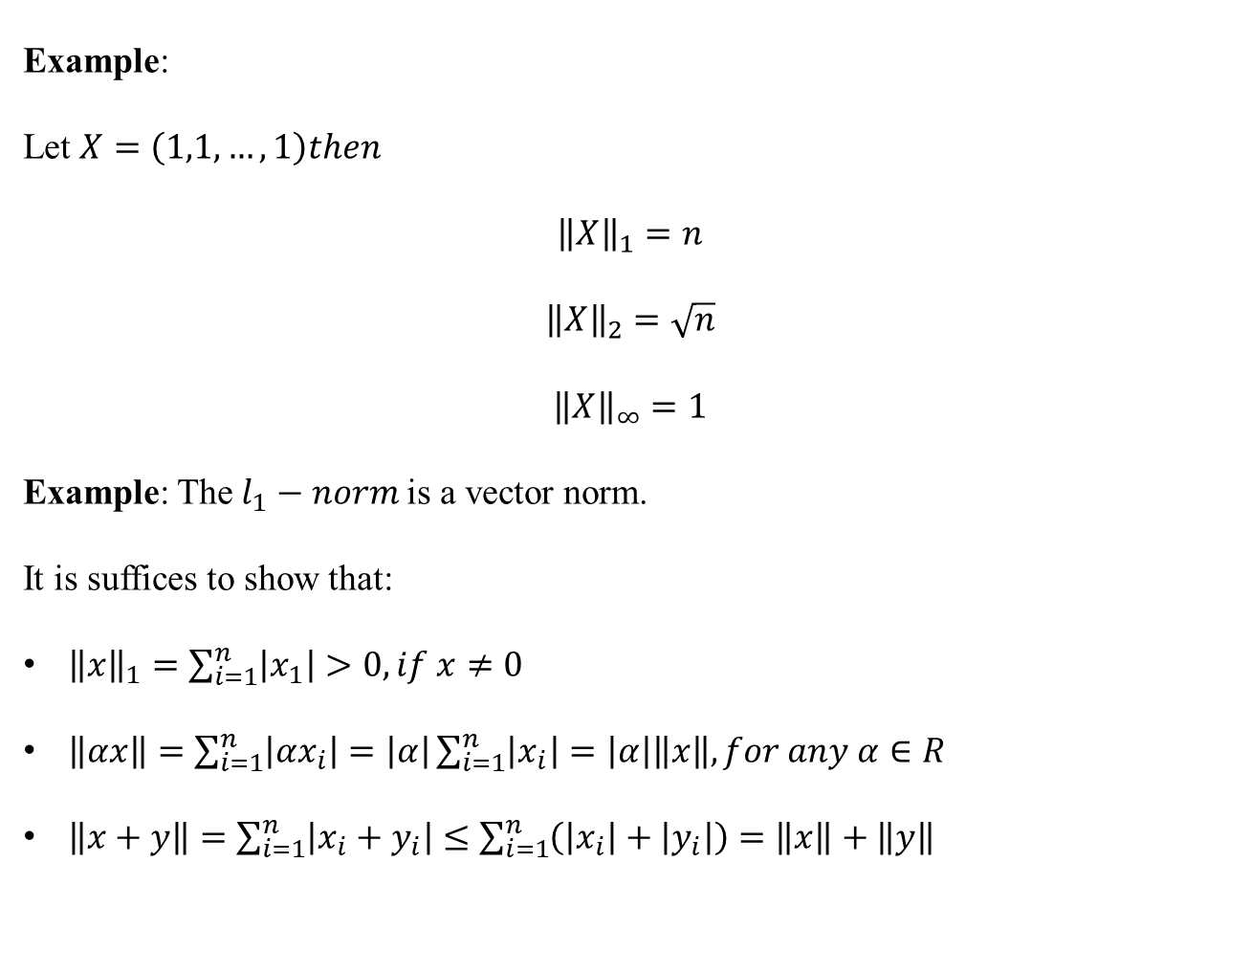
Norms
Example:
Let $X=\left(1,1,…,1\right)then$
$${\left\|X\right\|}_{1}=n$$
$${\left\|X\right\|}_{2}=\sqrt{n}$$
$${\left\|X\right\|}_{∞}=1$$
Example: The $l_{1}−norm$is a vector norm.
It is suffices to show that:
${\left\|x\right\|}_{1}=\sum_{i=1}^{n}{\left|x_{1}\right|}>0,if x≠0$
$\left\|αx\right\|=\sum_{i=1}^{n}{\left|{αx}_{i}\right|=\left|α\right|\sum_{i=1}^{n}{\left|x_{i}\right|}}=\left|α\right|\left\|x\right\|,for any α∈R$
$\left\|x+y\right\|=\sum_{i=1}^{n}{\left|x_{i}+y_{i}\right|≤\sum_{i=1}^{n}{\left(\left|x_{i}\right|+\left|y_{i}\right|\right)=\left\|x\right\|+\left\|y\right\|}}$

Slide 38
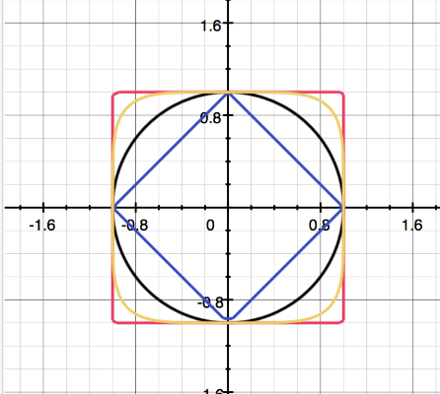

visualize $l_{p}−$norms
$${\left\|x\right\|}_{1}=1, {\left\|x\right\|}_{2}=1 ,{\left\|x\right\|}_{5}=1 , {\left\|x\right\|}_{∞}=1$$

Slide 39
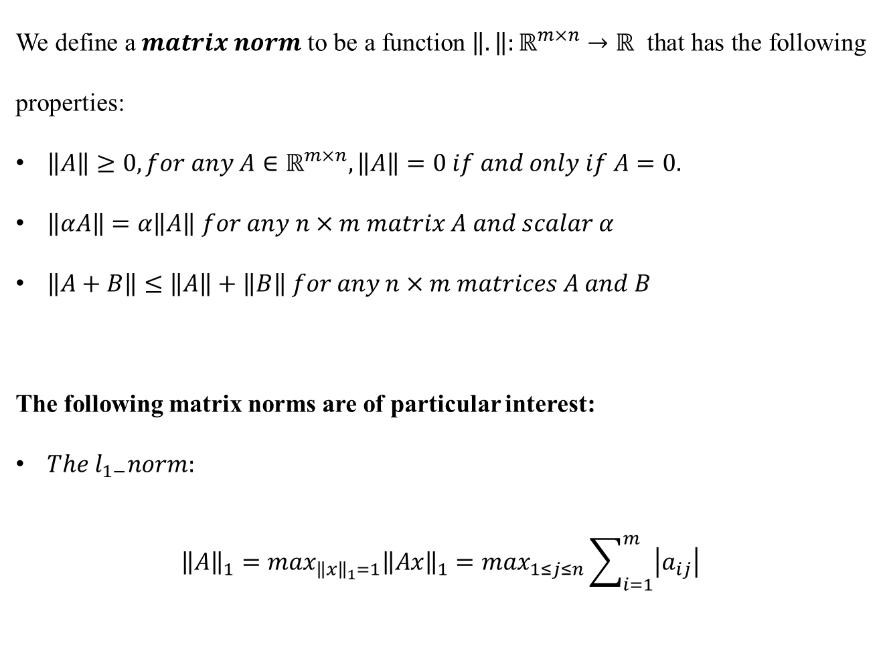
Matrix Norms
We define a $matrix norm$ to be a function $\left\|.\right\|:ℝ^{m×n}→ℝ$ that has the following properties:
$\left\|A\right\|≥0,for any A∈ℝ^{m×n},\left\|A\right\|=0 if and only if A=0.$
$\left\|αA\right\|=α\left\|A\right\| for any n×m matrix A and scalar α$
$\left\|A+B\right\|≤\left\|A\right\|+\left\|B\right\| for any n×m matrices A and B$
The following matrix norms are of particular interest:
$The l_{1−}norm:$
$${\left\|A\right\|}_{1}=\max_{{\left\|x\right\|}_{1}=1}{\left\|Ax\right\|}_{1}=\max_{1≤j≤n}\sum_{i=1}^{m}{\left|a_{ij}\right|}$$
Notes:
از کاربردهای نرم ماتریسی بالا و اسلاید بعد در حل عددی دستگاه معادلات خطی است

Slide 40

Matrix Norms
That is, the $l_{1}−norm$ of a matrix is its maximum column sum.
$The l_{∞}−norm:$
$${\left\|A\right\|}_{∞}=\max_{{\left\|x\right\|}_{∞}=1}{\left\|Ax\right\|}_{∞}=\max_{1≤i≤m}\sum_{j=1}^{n}{\left|a_{ij}\right|}$$
That is,$l_{∞}−norm$ of matrix is its maximum row sum.
Example: Let matrix A be $\left(\begin{matrix}1 & 2 \\ 3 & 4\end{matrix}\right) then:$
${\left\|A\right\|}_{1}=6 {\left\|A\right\|}_{∞}=7$

Slide 41
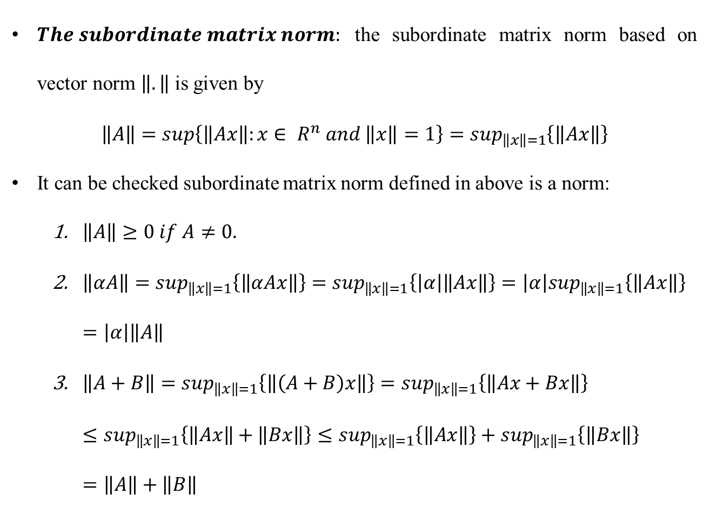
Matrix Norms
$The subordinate matrix norm:$ the subordinate matrix norm based on vector norm $\left\|.\right\|$ is given by
$$\left\|A\right\|=sup\left\{\left\|Ax\right\|:x∈ R^{n} and \left\|x\right\|=1\right\}=\sup_{\left\|x\right\|=1}\left\{\left\|Ax\right\|\right\}$$
It can be checked subordinate matrix norm defined in above is a norm:
$\left\|A\right\|≥0 if A≠0.$
$\left\|αA\right\|=\sup_{\left\|x\right\|=1}\left\{\left\|αAx\right\|\right\}=\sup_{\left\|x\right\|=1}\left\{\left|α\right|\left\|Ax\right\|\right\}=\left|α\right|\sup_{\left\|x\right\|=1}\left\{\left\|Ax\right\|\right\}=\left|α\right|\left\|A\right\|$
$\left\|A+B\right\|=\sup_{\left\|x\right\|=1}\left\{\left\|\left(A+B\right)x\right\|\right\}=\sup_{\left\|x\right\|=1}\left\{\left\|Ax+Bx\right\|\right\}≤\sup_{\left\|x\right\|=1}\left\{\left\|Ax\right\|+\left\|Bx\right\|\right\}≤\sup_{\left\|x\right\|=1}\left\{\left\|Ax\right\|\right\}+\sup_{\left\|x\right\|=1}\left\{\left\|Bx\right\|\right\}=\left\|A\right\|+\left\|B\right\|$

Slide 42
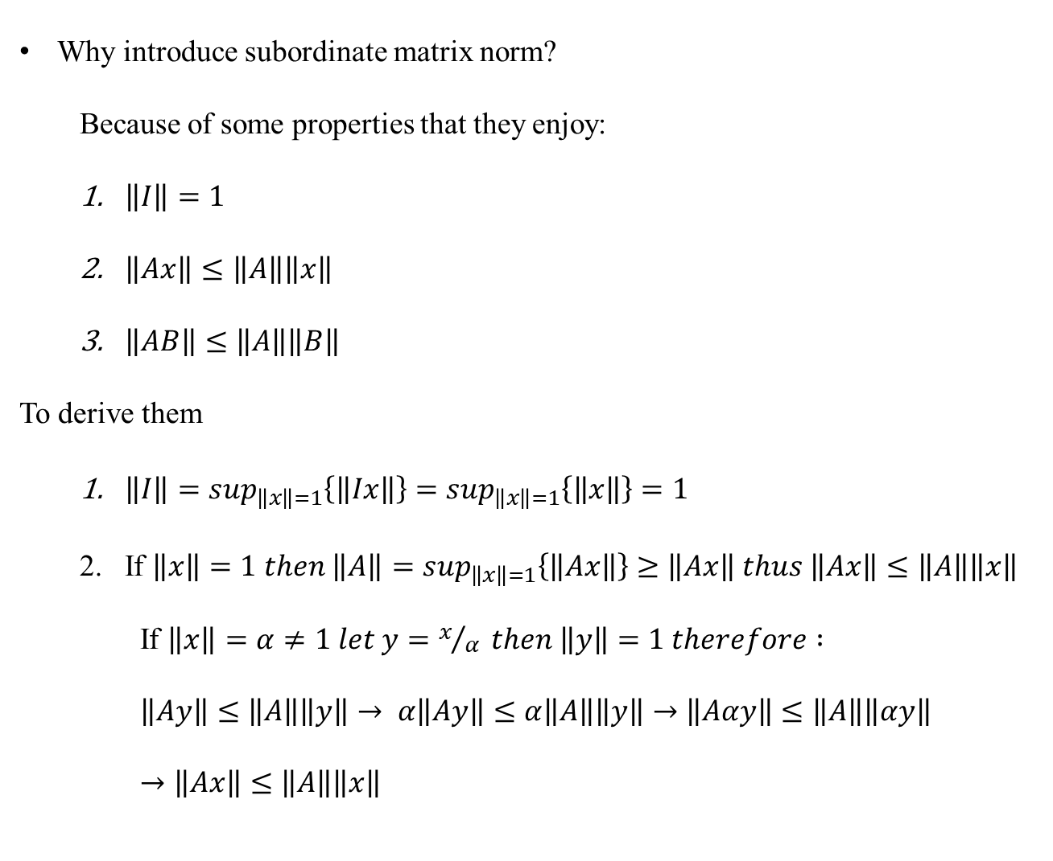
Matrix Norms
Why introduce subordinate matrix norm?
Because of some properties that they enjoy:
$\left\|I\right\|=1$
$\left\|Ax\right\|≤\left\|A\right\|\left\|x\right\|$
$\left\|AB\right\|≤\left\|A\right\|\left\|B\right\|$
To derive them
$\left\|I\right\|=\sup_{\left\|x\right\|=1}\left\{\left\|Ix\right\|\right\}=\sup_{\left\|x\right\|=1}\left\{\left\|x\right\|\right\}=1$
If $\left\|x\right\|=1 then \left\|A\right\|=\sup_{\left\|x\right\|=1}\left\{\left\|Ax\right\|\right\}≥\left\|Ax\right\| thus \left\|Ax\right\|≤\left\|A\right\|\left\|x\right\|$
If $\left\|x\right\|=α≠1 let y=x/α then \left\|y\right\|=1 therefore :$
$$\left\|Ay\right\|≤\left\|A\right\|\left\|y\right\|→ α\left\|Ay\right\|≤α\left\|A\right\|\left\|y\right\|→\left\|Aαy\right\|≤\left\|A\right\|\left\|αy\right\|→\left\|Ax\right\|≤\left\|A\right\|\left\|x\right\|$$

Slide 43
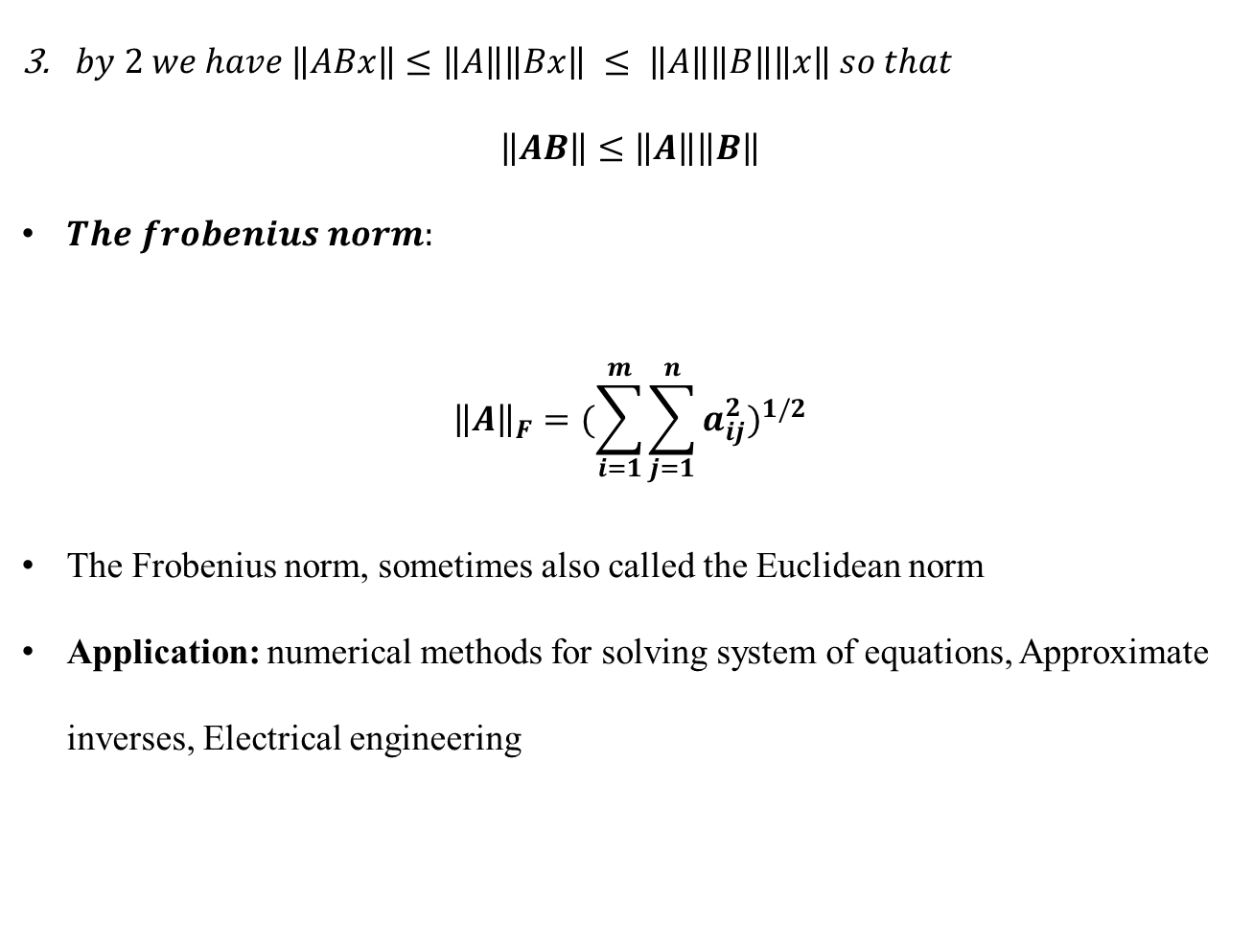
Matrix Norms
$by 2 we have \left\|ABx\right\|≤\left\|A\right\|\left\|Bx\right\| ≤ \left\|A\right\|\left\|B\right\|\left\|x\right\| so that$
$$\left\|AB\right\|≤\left\|A\right\|\left\|B\right\|$$
$The frobenius norm:$
$${\left\|A\right\|}_{F}={(\sum_{i=1}^{m}{\sum_{j=1}^{n}{a_{ij}^{2}}})}^{1/2}$$
The Frobenius norm, sometimes also called the Euclidean norm
Application: numerical methods for solving system of equations, Approximate inverses, Electrical engineering

Slide 44

Matrix Norms
Example:$Compute Frobenius Norm for the following matrix$
$$\left(\begin{matrix}2 & −2 & 1 \\ −1 & 3 & −1 \\ 2 & −4 & 1\end{matrix}\right)$$
$${\left\|A\right\|}_{F}=\sqrt{\sum_{i}{\sum_{j}{a_{ij}^{2}}}}=\left(2^{2}+{\left|−2\right|}^{2}+1^{2}+{\left|−1\right|}^{2}+3^{2}+{\left|−1\right|}^{2}+2^{2}+{\left|−4\right|}^{2}+1^{2}\right)≈6.40$$

